Slide 1
NS SHAFT
Software Studio 軟體設計與實驗
Hung-Kuo Chu
Department of Computer Science
National Tsing Hua University
CS2410

Slide 2
Important
We use Cocos Creator 2.2.2 in this course.
Please make sure you use the same version, otherwise your program may crash when we test it.

Slide 3
Goal
Fork repo Lab10-NS-SHAFT to your local repository.
Complete all TODOs written in GameMgr.ts and Platform.ts to create an platform game.

Slide 4
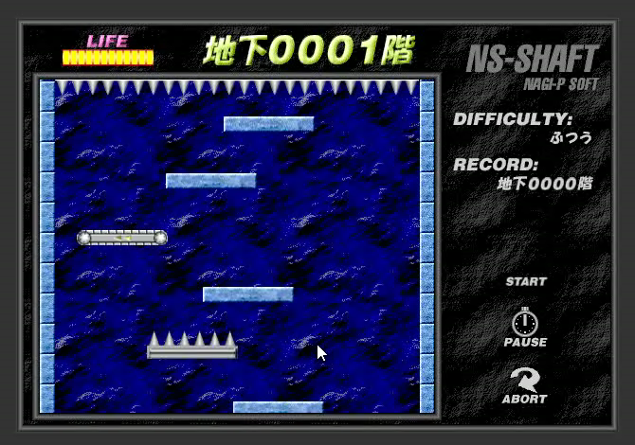
Goal (Cont'd)
Example Result
DEMO URL: https://105062302.gitlab.io/lab10-demo

Slide 5
Goal (Cont'd)
Deadline: 2020/05/19 18:00 (FTP upload time)
Please upload your source files to FTP and name your zip file as the following name format. Otherwise you will get 0 point.
Lab10_[studentID]_v1.zip
Lab10_[studentID]_v2.zip
…

Slide 6
Grading Policy
All objects in Game scene have correct physics effects, including collision and gravity value. 10%
Trampoline and Fake platforms need to play animation at the proper timing when the player touches them. 10%
Trampoline platform has spring effect when player touches it. 10%
Conveyor platform has delivery effect when player touches it. 10%
Cancel delivery effect when the player leaves Conveyor platforms. 5%
For Fake platform, the player should fall 0.2 seconds after he touches the platform. 15%

Slide 7
Grading Policy
All the platforms have only upside collision. You have to prevent collisions from the other directions. 15%
Player’s health decreases when player touches Nails platform, or increases when player touches other types of platform. 10%
Trampoline platform will always increase player’s health value if the player keeps jumping on it. 5%
All sound effects are played correctly. 10%
You will get 0 point if your program crashes during the test.

Slide 8
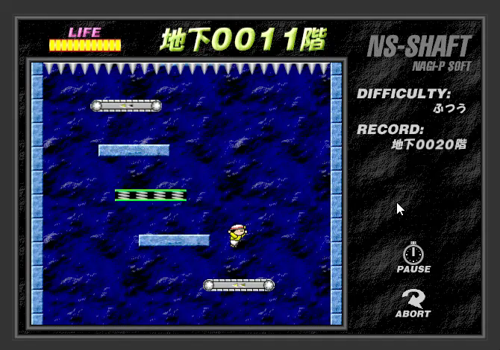
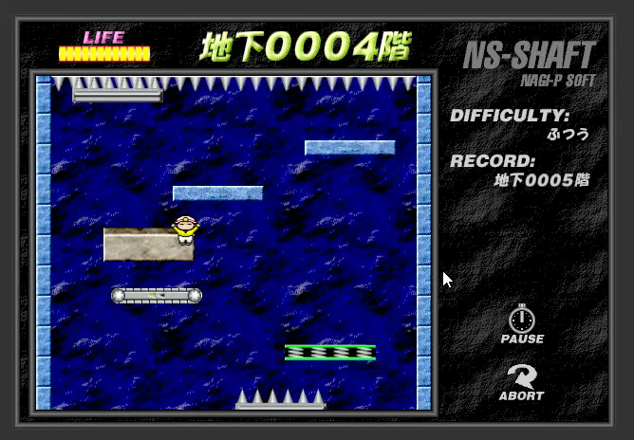
Cancellation of Delivery Effect
(O) Cancel delivery effect after leaving
(X) Do not cancel delivery effect
after leaving

Slide 9
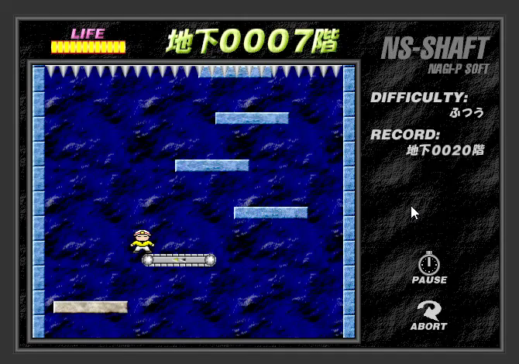
Fake Platform Effect

Slide 10
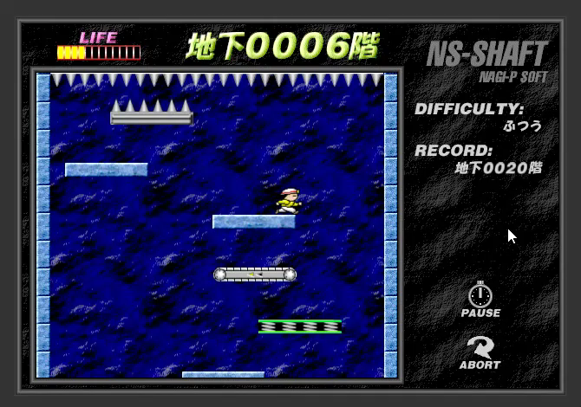
Spring Effect

Slide 11
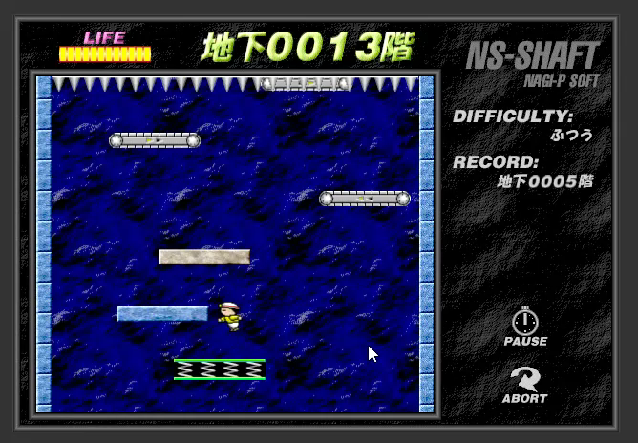
One Side Collision

